Slide 1
Understanding and Practicing Arduino
Phenomena

Slide 2
Today’s Focus
Design Your Own Circuit
Write Your Own Program

Slide 3
Today’s Task
Parking Sensor
Ultrasonic x1
RGB LED x1

Slide 4
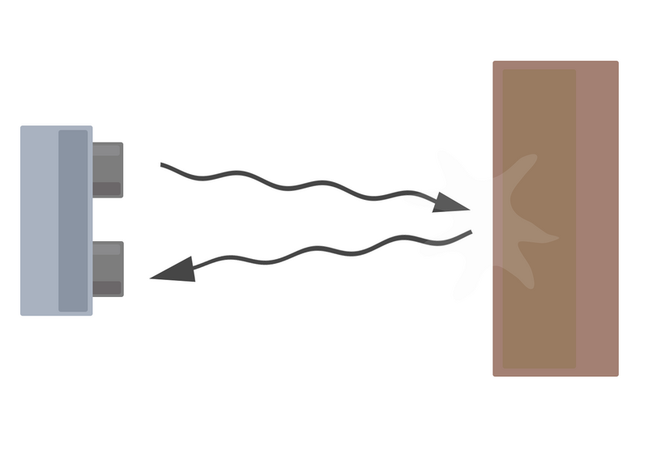
Ultrasonic
Distance = (speed of sound * time taken) /2

Slide 5
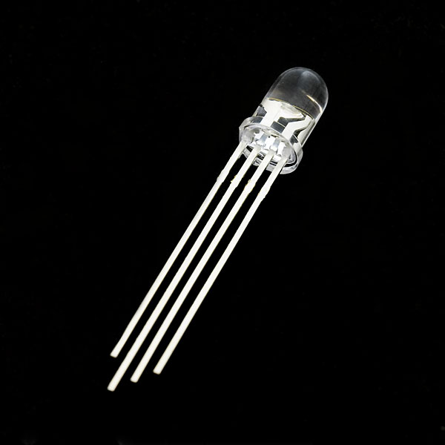
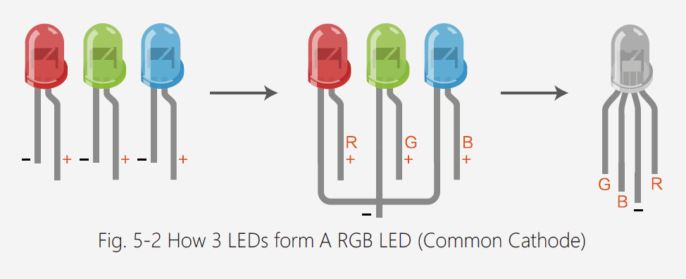
RGB LED

Slide 6
if (…){…} else {…} Statement
An if statement can be followed by an optional else statement, which executes when the Boolean expression is false.
If ( condition ) // true or false
{
// statement
}
else
{
// statement
}

Slide 7
Your Task
Build a circuit that connects both the RGB LED and Ultrasonic Sensor to the Arduino.
Write a program to complete following tasks:
If the distance between the obstacle and the ultrasonic sensor is greater than 120 ➔ no lights turn on.
Else if the distance between the obstacle and the ultrasonic sensor is greater than 90 but smaller than 120 ➔ turn on the GREEN light.
Else if the distance between the obstacle and the ultrasonic sensor is greater than 60 but smaller than 90 ➔ turn on the YELLOW light.
Else if the distance between the obstacle and the ultrasonic sensor is greater than 30 but smaller than 60 ➔ turn on the RED light.
Else ➔ turn on ALL the lights.

Slide 8
A Document for Brain Storming
The Idea Gathering Document:
https://docs.google.com/document/d/1fLm2RJOFSxDVxatytCI86R-EuLYS0xKe0N-XZOGQZIs/edit

Slide 9
Great Work
Have a Wonderful Week!

